Slide 2


Slide 3
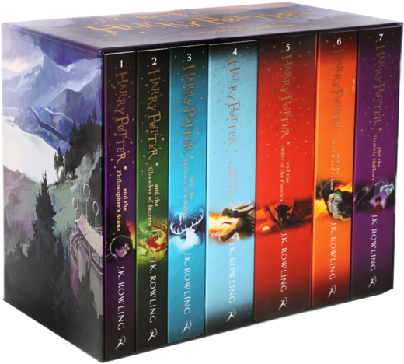

Slide 4


Slide 5
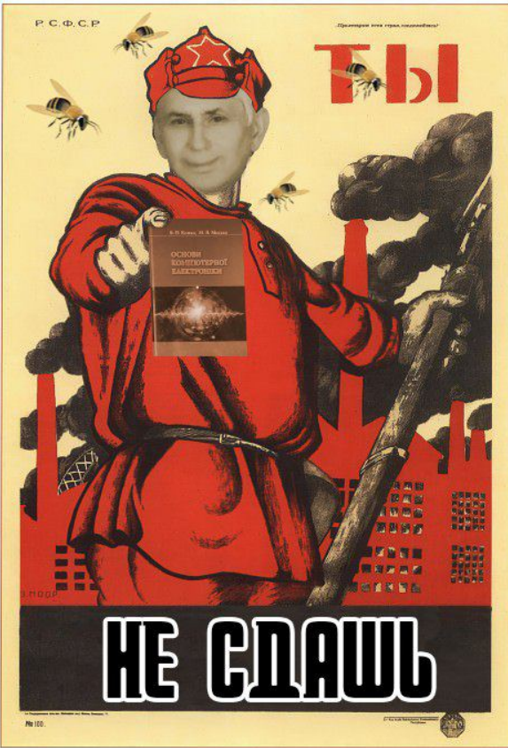

Slide 6


Jack London

Slide 7
White Fang (Біле Ікло)
The Sea-Wolf
The Call of the Wild
The Iron Heel

Slide 8


Slide 9


Slide 10
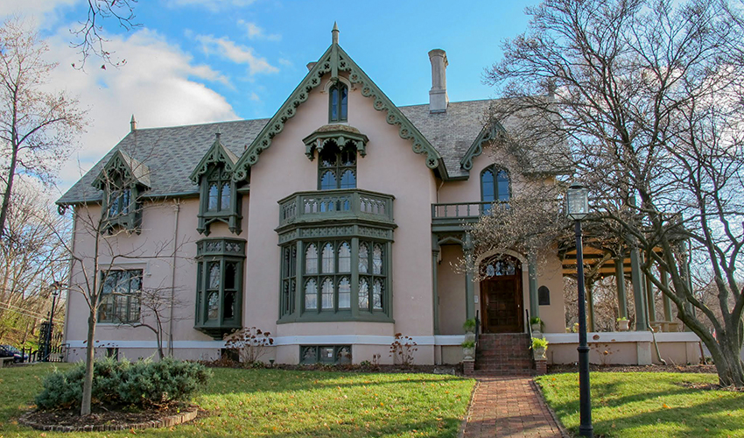

Slide 11


Slide 12
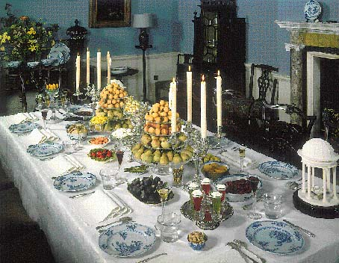

Slide 13
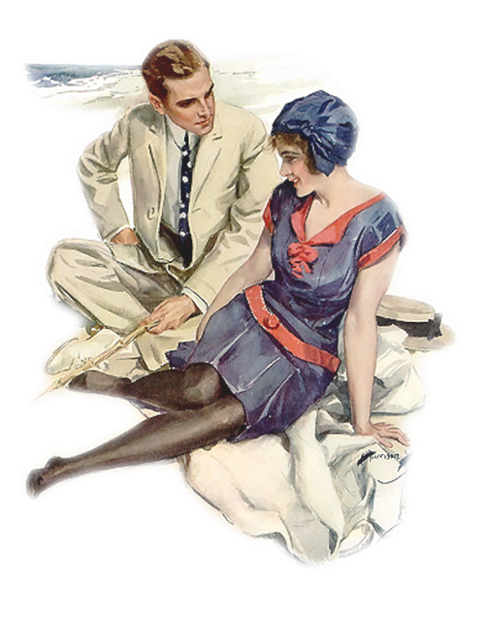

Slide 14
Thanks for your attention ☺

